Slide 1
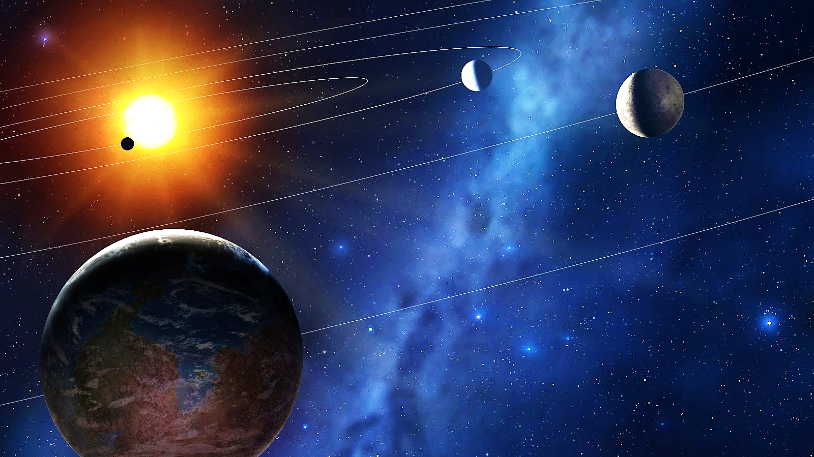

Detecting Exoplanets using Raw Data from NASA’s Kepler Spacecraft
Kaitlin
Puryear
Notes:
Hello Ladies and Gentlemen! Thank you all for coming to visit Metis this evening.
My name is Kaitlin Puryear and
before I transitioned into studying Data Science, I was an Astrophysicist!

Slide 2
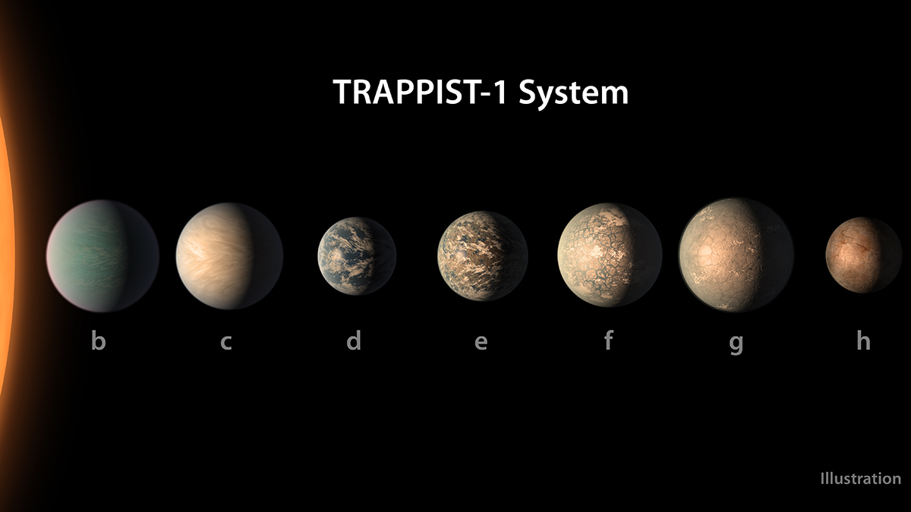
Exoplanet: (noun)
a planet that orbits a star outside our solar system.
ex·o·plan·et, (ˈeksōˌplanət)
3708 exoplanets confirmed to date
“The universe is a pretty big place. If it's just us, seems like an awful waste of space.”
- Carl Sagan
Notes:
Before we begin, lets briefly define ”Exoplanet”

Slide 3
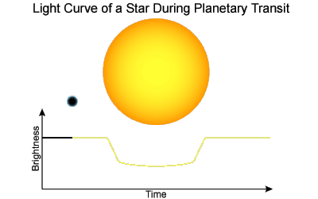
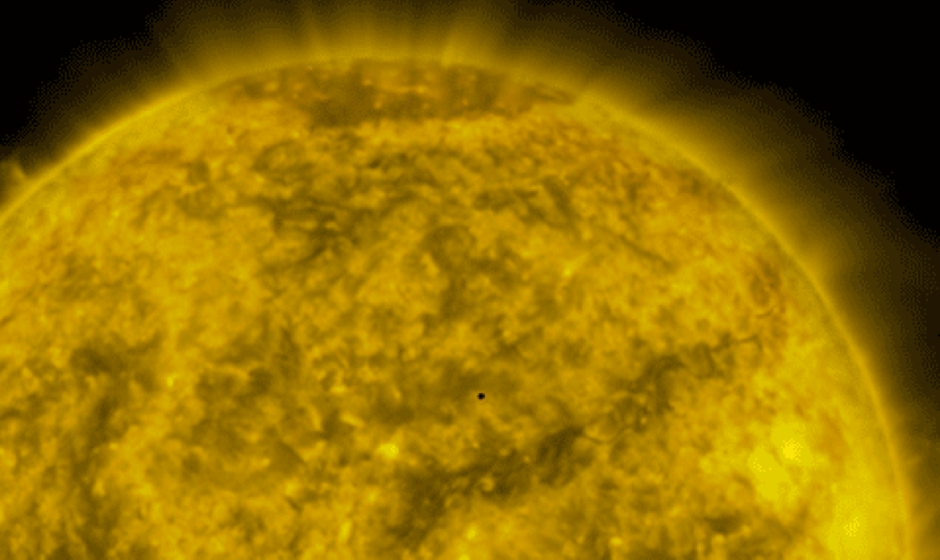
Raw Data: Light Curves
Notes:
Looking at a single lamp post 100 blocks away, and being able to see a fly buzzing around the light

Slide 4
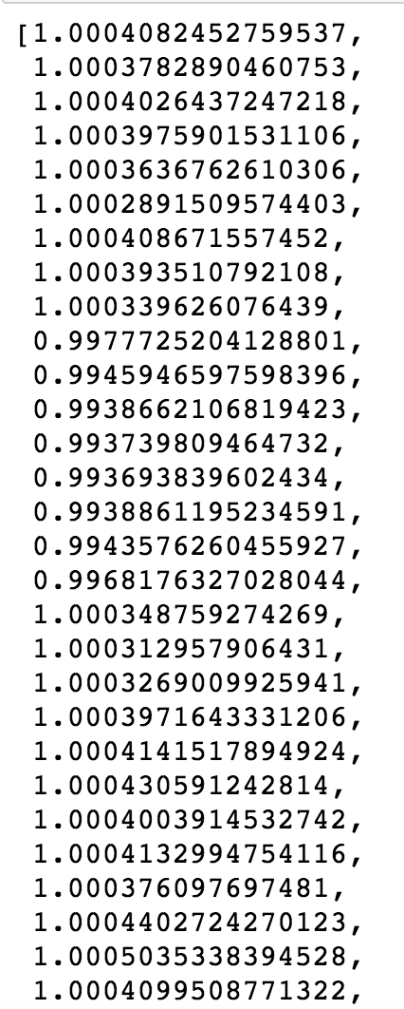

Data Pre-processing Pipeline
.fits file
target pixel file
light curve
pandas dataframe
1D vector
Spoke with some Data Scientists at NASA JPL
Used a package called LightKurve that was created by Kepler GO office
Notes:
When I started working on this problem, I reached out to some folks from NASA. They were extremely accommodating, and gave me access to their package called LightKurve.

Slide 5
Understanding the Light Curve Data
Flux:
Measured every hour for 1 week
1626 rows total/star
9564 stars total

Slide 6

Feature Engineering
Min Flux
Max Flux
Delta Flux
First Percentile
Third Percentile
Fifth Percentile
Flux:
Measured every hour for 1 week
1626 rows total/star
9564 stars total

Slide 7
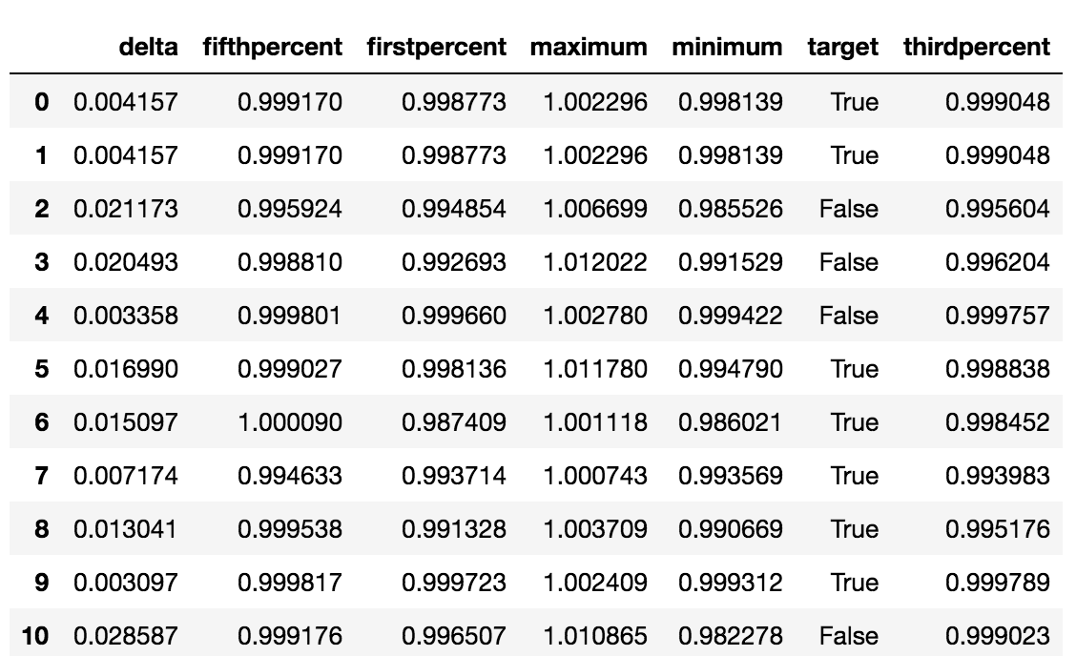
Feature Engineering
Min Flux
Max Flux
Delta Flux
First Percentile
Third Percentile
Fifth Percentile
Target

Slide 8
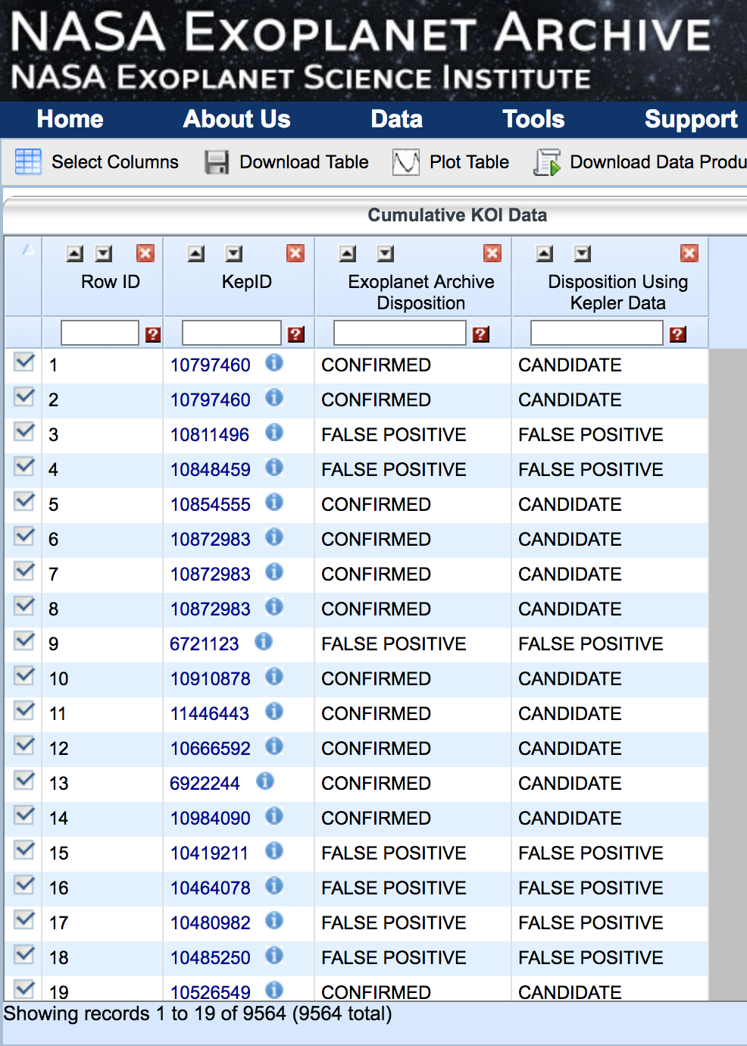
Curate the Target Data
Match KepIDs, and create the targets for the dataset.
Labelled Data acquired from NASA Exoplanet Archive.
True = confirmed
False = false positive
No confirmed negatives.

Slide 9
Building a Model to Detect Planets
Input
Dataset with 6 features:
Minimum Flux
Maximum Flux
Delta flux
1st percentile
3rd percentile
5th percentile
Output
Classification:
- True = Exoplanet
- False = Not an Exoplanet
Model
Notes:
Here is the general model flow.

Slide 10
My model pings this star as requiring further investigation, it might have an exoplanet around it.
Scientists investigate, and there is no exoplanet there.
The model will attempt to minimize this kind of error, so scientists do not waste their time, effort and money.
Not an
Exoplanet
Model is
INCORRECT
It is actually…
Model is
INCORRECT
Exoplanet
Not an
Exoplanet
Exoplanet
My model predicts…
Notes:
Data Scientist know this chart as a confusion matrix. I will use this confusion matrix to discuss the ramifications of types 1 and 2 error.

Slide 11
This type of error is very uncommon in this dataset
- the data contains positives
and false positives only.
Not an
Exoplanet
Model is
INCORRECT
It is actually…
My model tells scientists we can ignore this star.
We miss discovering
an exoplanet.
Model is
INCORRECT
Exoplanet
Not an
Exoplanet
Exoplanet
My model predicts…

Slide 12
Modeling Exoplanets
(1, 1626) Vector
Feature
Engineered Dataset
Trial 1: Artificial Neural Network
2 different Keras/Tensorflow models
Problems with type of NN.
Trial 2: Ensembled Categorical Models
3 different ensembled models
Tended to overfit the training set
Trial 3: Simple Random Forest
Works!
Should
use
Should
use
Convolutional Neural Network
Neural Network as a Regression
Notes:
To model this problem I attacked it from 3 different angles.
I started with trying to model it using an Artificial Neural Network.

Slide 13
Modeling Exoplanets
Logistic Regression
Logistic Regression
Trial 1: Artificial Neural Network
2 different Keras/Tensorflow models
Problems with type of NN.
Trial 2: Ensembled Categorical Models
3 different ensembled models
Tended to overfit the training set
Trial 3: Simple Random Forest
Works!
Random Forest
Random Forest
Random Forest
Decision Tree
Notes:
I then tried stacking categorical models on top of each other. Using one model to narrow down the pool of exoplanet possibilities, then using the next model to par it down further.

Slide 14
Modeling Exoplanets
Trial 1: Artificial Neural Network
2 different Keras/Tensorflow models
Problems with type of NN
Trial 2: Ensembled Categorical Models
3 different ensembled models
Tended to overfit the training set
Trial 3: Simple Random Forest
Works!

Slide 15
Trial 3: Simple Random Forest
My model predicts…
Random Forest Model
Not an
Exoplanet
570
432
Highest Recall
Highest AUC score
Highest Test Accuracy
Highest F1 Score
Minimized False Positives more than any other model
Type I error: 21.9%
Type II error: 11.9%
0.76
0.722
66%
0.69
It is actually…
236
734
Exoplanet
Not an
Exoplanet
Exoplanet
Notes:
Depth of 15 with number of estimators 51.
There is still room for improvement, but this model minimized false positives more than any other model.
My model correctly identified76% of all the exoplanets in the dataset.

Slide 16
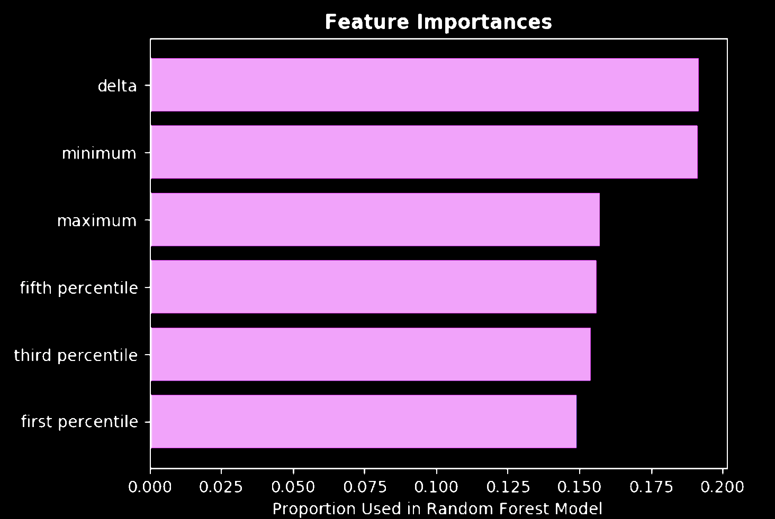
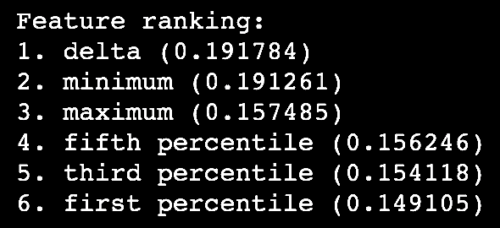
Trial 3: Simple Random Forest
Notes:
Out of the 6 features I engineered, the features that are most important were the delta and minimum.

Slide 17

Conclusions
The biggest factor in determining exoplanet candidacy is the flux delta.
A larger delta means more likely to be an exoplanet
Sometimes a simple model can answer a complex question.
We still have a lot to learn about how our universe works.

Slide 18
Future Work
Obtain Negative Star Data
Obtain more periodicity
Engineer more features: length of transit, more percentiles
Write a model that takes the data, start to finish

Slide 19
Thank you! Happy to take questions
Special thanks to NASA’s Kepler Guest Observer Team and the NASA Exoplanet Archive.
Kaitlin Puryear
http://kpuryear.github.io
kaitlinpuryear@gmail.com
Notes:
Thank you so much for your time and attention. I look forward to taking any questions you might have.
A special thanks to NASA’s Kepler GO team and the NASA Exoplanet Archive.

Slide 20
Sources
Kepler Guest Observer Office
https://keplerscience.arc.nasa.gov/helpdesk.html
Kepler GO GitHub Repo
https://github.com/KeplerGO/
NASA Exoplanet Archive
https://exoplanetarchive.ipac.caltech.edu/
Kepler Telescope Database
https://exoplanetarchive.ipac.caltech.edu/cgi-bin/TblView/nph-tblView?app=ExoTbls&config=koi
LightKurve Docs
http://lightkurve.keplerscience.org/tutorials/quickstart.html
lightkurve Package
authors = Zé Vinícius,
Geert Barentsen, Christina Hedges
Michael Gully-Santiago, Ann Marie Cody
title = KeplerGO/lightkurve
month = feb
year = 2018
doi =10.5281/zenodo.1181928
url =http://doi.org/10.5281/
zenodo.1181928

Slide 21
Sources
Kepler Guest Observer Office
https://keplerscience.arc.nasa.gov/helpdesk.html
Kepler GO GitHub Repo
https://github.com/KeplerGO/
NASA Exoplanet Archive
https://exoplanetarchive.ipac.caltech.edu/
Kepler Telescope Database
https://exoplanetarchive.ipac.caltech.edu/cgi-bin/TblView/nph-tblView?app=ExoTbls&config=koi
LightKurve Docs
http://lightkurve.keplerscience.org/tutorials/quickstart.html
Images
https://www.google.com/search?q=dictionary+exoplanet
https://www.nasa.gov/feature/jpl/new-clues-to-trappist-1-planet-compositions-atmospheres/
https://community.dur.ac.uk/physics.astrolab/exoplanets.html
https://spaceinvader.me/2017/03/02/fourth-planet-from-trappist-added-to-habitable-exoplanet-list
http://wwf.panda.org/about_our_earth/all_publications/lpr_2016/

Slide 22


Slide 23
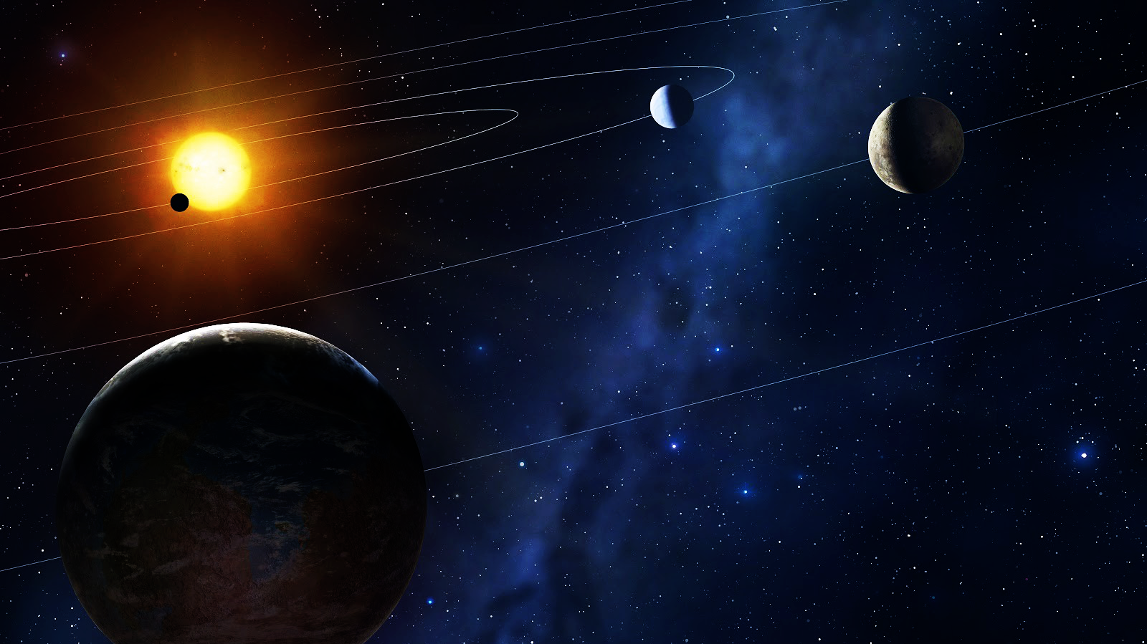
Detecting Exoplanets using Raw Data from NASA’s Kepler Spacecraft
Planets that exist outside our
Solar System
Light Curves from the stars that have planets orbiting them
NASA’s primary exoplanet detection spacecraft

Slide 24
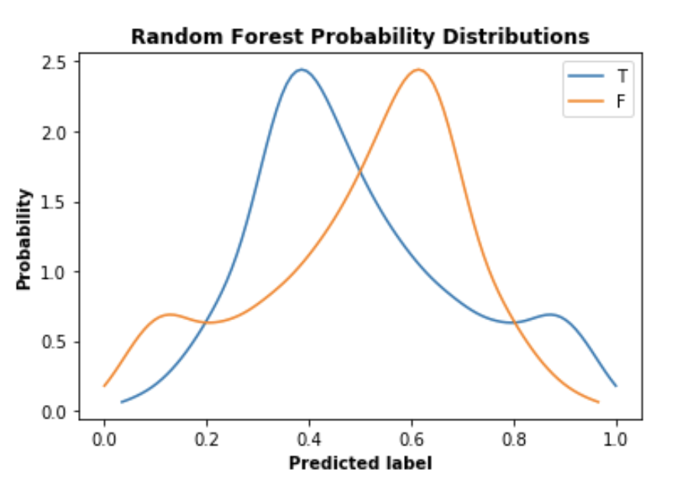

Slide 25
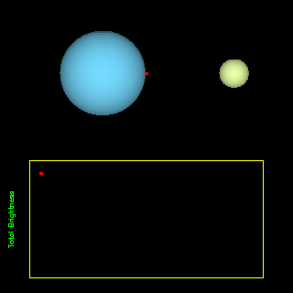
False Positives
Not an
Exoplanet
False
Positives
Eclipsing binary stars
Interstellar debris
Comets
Asteroids
It is actually…
Exoplanet
Not an
Exoplanet
Exoplanet
My model predicts…
Notes:
Detecting and categorizing False Positives is a whole area of study within Transit Analysis. It is a very interesting problem on its own. There are many things that could cause a False Positive.

Slide 26
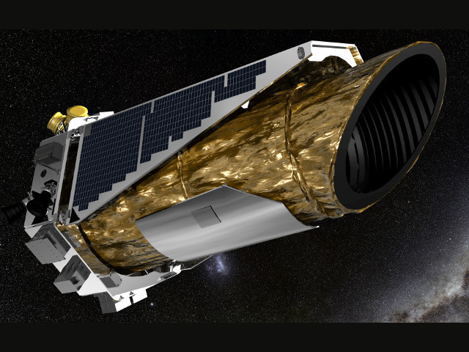
Kepler Spacecraft
Launched in: 2009
Mission objectives: discover exoplanets via transit technique
Discoveries to date:
https://astronomynow.com/2016

Slide 27
Model Comparisons
 | Overall Test Accuracy | “True” Recall | “True” Precision | Overall F1 Score | AUC
Random Forest | 66.0% | 0.76 | 0.63 | 0.69 | 0.722
Logistic Regression | 50.8% | 0.00 | 0.00 | 0.00 | 0.567
Decision Tree | 60.85% | 0.79 | 0.57 | 0.66 | 0.627
Keras Model 2 | 25.3%
Keras Feature Model | 50.81%
RF + RF | 58.90% | 0.82 | 0.64 | 0.72 | 0.57
RF + DT | 52.74% | 0.88 | 0.63 | 0.73 | 0.56
LR + LR | 54.41% | 0.99 | 0.51 | 0.67 | 0.54

Slide 28
Building a Neural Network for Detecting Planets
Input
(1, 1626) vector of fluxes for the star in question
Output
Classification
- Yes exoplanet
- Not an exoplanet
Artificial
Neural
Network

Slide 29
Trial 1: Building a Neural Network to Detect Planets
Input Layer
Artificial Neural Network: Built From Scratch
Models built with Keras/Tensorflow
Implemented decaying learning rate
Forced 0.25 node dropout
Optimized based on loss validation and accuracy
Raw (1626, 1)
vectors
Feature Engineered
DataFrame
Highest Accuracy
Achieved: 45%
Output Layer
Notes:
Why does this method not work?
Too basic?
Maybe should’ve used CNN?
Artificial neural net doesn’t take context
Artificial Neural Net as a regressor? CONFirm?

Slide 30
Trial 2: Ensemble Model to Detect Planets
Model 1
Gross Classification
Delicate Classification
Finer-toothed comb
Model 2
Optimize Model 1 to weed out False Negatives.
Model 2 takes the positive output of Model 1.
Optimize Model 2 to minimize False Positives.
Notes:
Decision Trees, Random Forest, Logistic Regression
Optimize Model 1 to weed out False Negatives.
Model 2 takes the positive output of Model 1.
Optimize Model 2 to minimize False Positives.

Slide 31
Trial 2: Ensemble Model to Detect Planets
Model 1
Logistic Regression
Random Forest
Random Forest
Gross Classification
Delicate Classification
Finer-toothed comb
Model 2
Logistic Regression
Decision Tree
Random Forest
Highest Accuracy Achieved: 60%
Notes:
Decision Trees, Random Forest, Logistic Regression

Slide 32
Building a Neural Network for Detecting Planets
Input Layer
Output Layer
Hidden Layers

